Slide 1
Real Estate Values Based on Introduction of New Professional Sports Teams
Real Estate Group

Slide 2
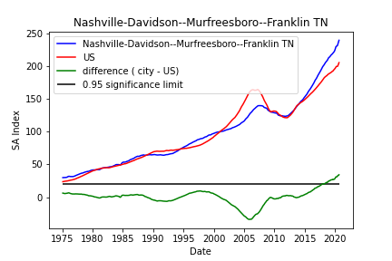



Slide 3












